Slide 1


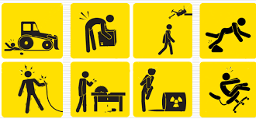
INDUSTRIAL SAFETY MANAGEMENT
UNIT-I (Module 1) - Importance of Safety consciousness in Indian Chemical Industries - Development of Industrial Health and Safety

Slide 2

What is
Safety is the state of being "safe“ the condition of being protected from harm or other non-desirable outcomes.
(OR) the condition of being safe from undergoing or causing hurt, injury, or loss
Safety can also refer to the control of recognized hazards in order to achieve an acceptable level of risk

Slide 3
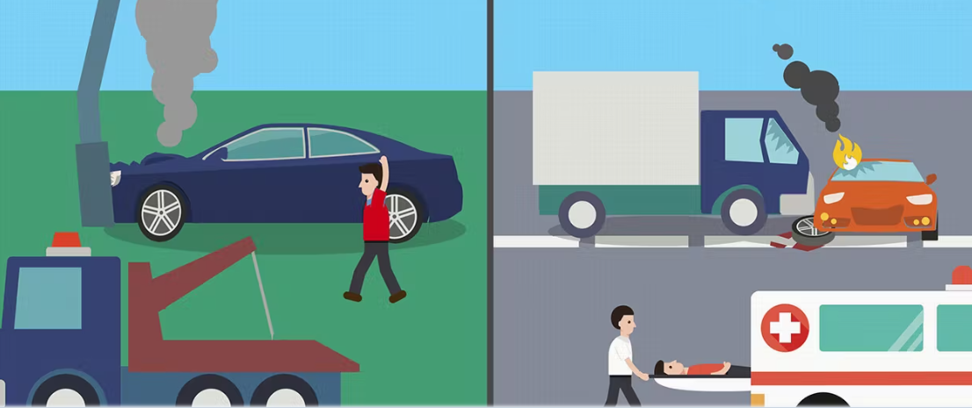
Incident vs Accident

Slide 4
Industrial Disasters

Slide 5
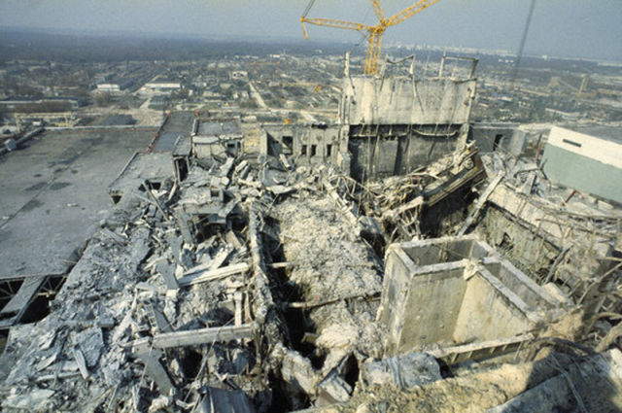
World’s worst Industrial Disasters
Chernobyl Disaster
The worst nuclear power plant disaster in history happened on April 26, 1986, when an explosion at Reactor 4 of Ukraine's Chernobyl power plant spewed a cloud of radioactivity over Europe and the Soviet Union.
The explosion killed 31 people, but the long-term effects are still unknown. About 4,000 people, most of whom were children in 1986, developed thyroid cancer as a result of the incident

Slide 6
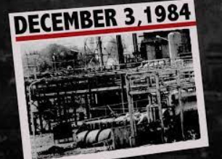
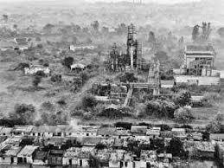
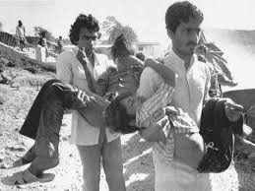
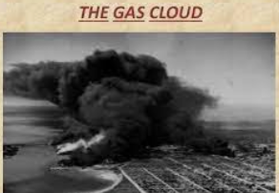
Bhopal Tragedy
Early on Dec. 3, 1984, a pesticide plant run by Union Carbide in Bhopal, India, spewed about 36 tonnes of deadly methyl isocyanate gas into the city's air, quickly killing about 4,000 people, according to local government estimates

Slide 7
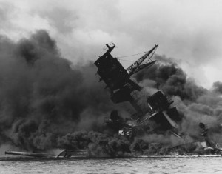
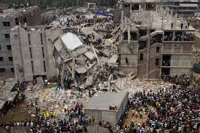
World’s worst Disasters
a cargo ship fully loaded with wartime weapons collided with a Norwegian ship November 6, 1917. The collision soon resulted in a fire and ignited the explosives on the cargo which resulted in a huge explosion killing or injuring anyone in the vicinity. Around 2000 people were killed and 9000 injured by fires, debris of explosion and collapsed buildings.
THE HALIFAX EXPLOSION, CANADA
collapse of an eight story commercial building in Savar, Bangladesh on April 24, 2013 killing around 1129 people and injuring over 2500 people.
SAVAR BUILDING COLLAPSE, BANGLADESH

Slide 8

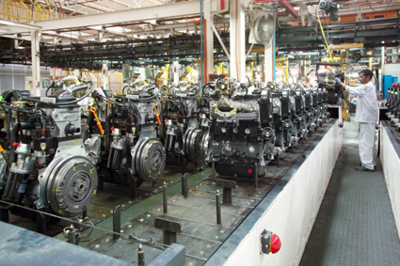



Industrial Domain
Storage (Raw Material - Solid, Liquid, Gases)
Process Plant & Machinery
Utilities ( Power, Steam,
Nitrogen etc.)
Finished Product
People (Operation,
Maintenance and Supporting
Staff)

Slide 9
Industrial Accidents
Industrial Accidents are caused by chemical, mechanical, civil, electrical, or other process failures due to accident, negligence or incompetence, in an industrial plant which may spill over to the areas outside the plant causing damage to life and property.”

Slide 10
How industrial accidents originating?

Slide 11
Industrial Accidents
These may originate in:
Manufacturing and formulation installations including during commissioning and process operations; maintenance and disposal.
Material handling and storage in manufacturing facilities, and isolated storages; warehouses and godowns including tank farms in ports and docks and fuel depots.
Transportation (road, rail, air, water, and pipelines).

Slide 12
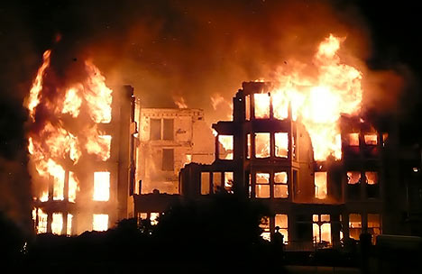
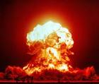
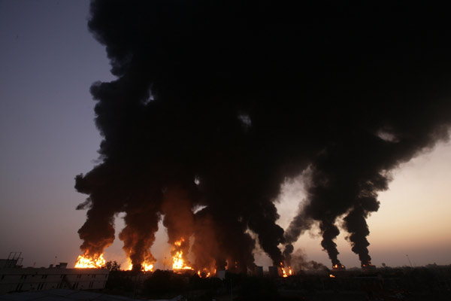
Major Threats
Fire
Explosion
Toxic release
Poisoning
Combinations of the above

Slide 13
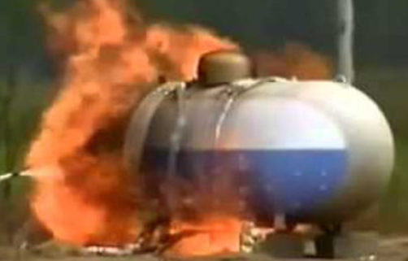
PROBABLE CAUSES OF ACCIDENTS
Process deviations i.e pressure, temperature & flow
Parameters with regard to the state of the substance i.e., solid, liquid or gas, proximity to other toxic substances
Runaway reaction
Hardware failure, resulting in large-scale spills of toxic substances
Boiling Liquid Expanding Vapour Explosion (BLEVE) on the chemicals during transportation

Slide 14
Impact of Industrial Accidents

Slide 15
Industrial Accidents
Living Organisms
Environment
Property
Immediate, Short-term
and Long-term Effects
Humans Livestock Plants
Soil and Water Bodies
Atmosphere
Death, Injury, Disease and Disability
Pollution

Slide 16
Major Consequences
Loss of life / injuries
Impact on livestock
Damage to Flora/fauna
Environmental Impact (air, soil,water)
Financial losses to industry

Slide 17
Safety consciousness - Introduction
Safety consciousness is the most potent factor in the prevention of accidents.
Safety consciousness may be defined as awareness of hazards and alertness to danger.
Throughout the day many tasks will be repeated with little conscious thought
- This can make work dull and increases chance of accident
Safety consciousness is the vital part of our work
Safety training is conducted to make you aware that danger exist all around you everyday

Slide 18
Importance of Safety consciousness in Indian Chemical Industries
(1) Occupational health and safety is more than accident prevention — that it encompasses all aspects of working conditions;
(2) Management's commitment to health and safety is crucial;
(3) Safety training is a critical component of any health and safety programme;
(4) Recognize a number of occupational hazards and some of the types of work generally associated with those hazards;
(5) Discuss the range of hazards in their own workplaces.

Slide 19
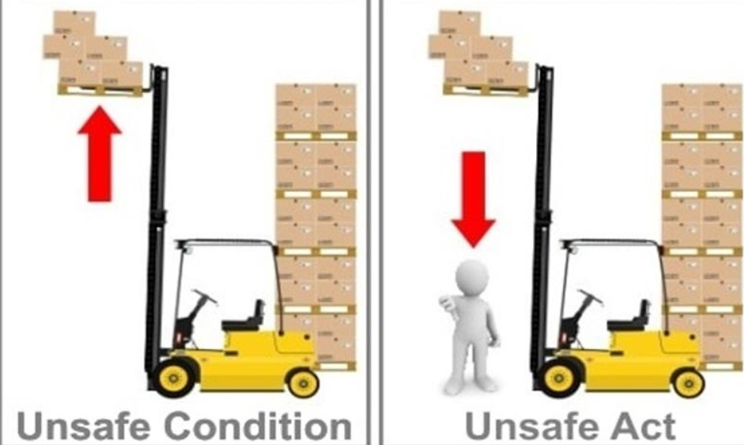
Unsafe condition vs Unsafe Act

Slide 20
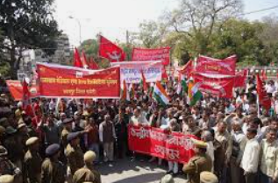



Development of Industrial Health and Safety
For the betterment of working conditions and ensuring safety of the workmen. There are number of factors which have directly or indirectly contributing :
The trade union movement has grown and come to be recognized as the integral part of the social control system
The safety legislations has undergone revisions during past few decades for better conditions of work and increased responsibility for safety on the part of employer
In Management itself, new theories have emerged advocating a changed approach to the human tasks
The all round consciousness generated and management found many volumnious bodies to promote health and safety in industry
Improvement of the standard of education of workers which made them conscious of the hazards around and their right for protection

Slide 21
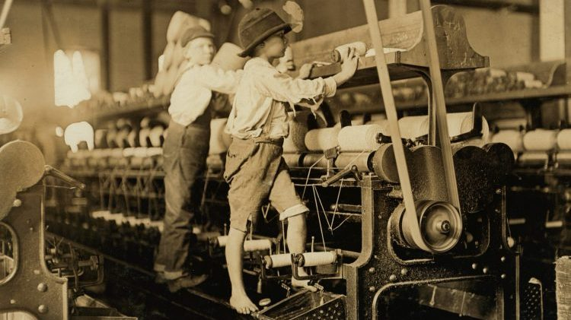
Evolution of workplace safety (1700-1860)

Slide 22
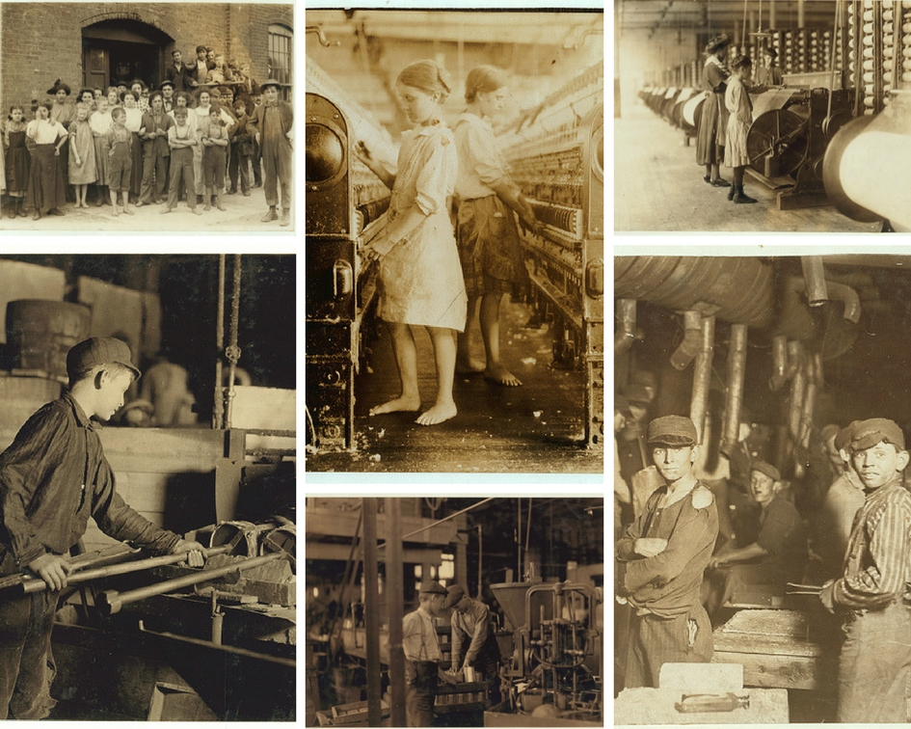

Slide 23
Developments in occupational health
In early 1940s rapid and extensive developments in occupational health began
Industries – Mining (always hazardous) need health and safety
In 18th century, technological inventions laid and the workers of all grades to the pressures of increasing production and associated with psychological hazards of work
Other like poor housing, overcrowding and lack of sanitation caused by the concentration of an expanding population around new factories led to the development of public health services

Slide 24
Developments in occupational health
In 19th century, the workers were exposed to hazards of occupational disease and injury and adverse effect of long hours of work – Group occupational health service have been set up to meet the needs of small plants.
During 20th century, trade unions began to influence an occupational health by pressing improvements in legislation and for the extension of compensation laws to cover occupational injuries and diseases

Slide 25

Occupational Safety and health (OSH)
Occupational safety and health (OSH), also commonly referred to as occupational health and safety (OHS), occupational health, or workplace health and safety (WHS), is a multidisciplinary field concerned with the safety, health, and welfare of people at work
The goals of occupational safety and health programs include to foster a safe and healthy work environment.
OSH may also protect co-workers, family members, employers, customers, and many others who might be affected by the workplace environment.

Slide 26

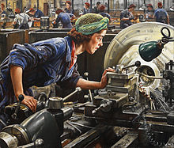
OSHA
Occupational Safety and Health Act of 1970, Congress created the Occupational Safety and Health Administration (OSHA) to assure safe and healthful working conditions for working men and women by setting and enforcing standards and by providing training, outreach, education and assistance
Harry McShane, age 16, 1908. Pulled into machinery in a factory in Cincinnati and had his arm ripped off at the shoulder and his leg broken without any compensation.
This painting depicts a woman examining her work on a lathe at a factory in Britain during World War II.

Slide 27
OSHA
One of the intentions of OSHA is Worker’s compensation was to advance occupational safety programmes. It will motivate the employer to institute safety programmes as a logical defence against such increasing expense
Employees are provided certain rights under OSHA:
(1)The right to request the secretary of labour in writing for safety and health inspections in plant, work establishment or job site
(2) The right to maintain accurate records of employee exposures to potentially toxic materials
(3)The right to identify dangerous substances by labelling or posting in the plant/job site

Slide 28

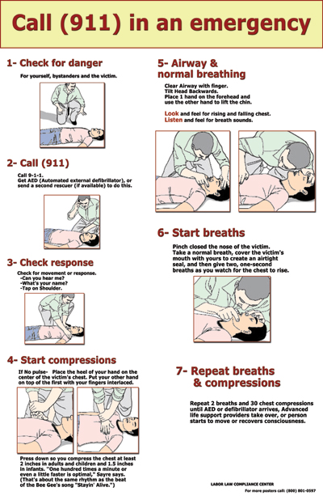

(4) The right to be informed promptly of any exposure to toxic materials / physical agents that are present in excess of those prescribed under safety standards
(5)The right to know about the safety violations by the employer as noticed by the compliance officer
OSHA requires workers to comply with safety standards
Read the OSHA poster

Slide 29


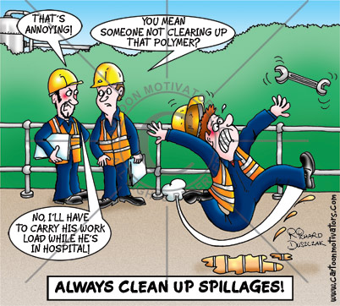
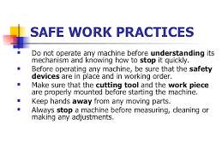
(2) Follow the employer’s safety and health rules and wear or use all required gear and equipment
(3)Follow safe work practices for your job, as directed by the employer

Slide 30
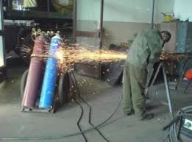
(4) Report hazardous conditions to a supervisor or safety committee
(5)Report hazardous conditions to OSHA, if employers do not fix them
(6)Cooperate with OSHA inspectors

